Slide 1

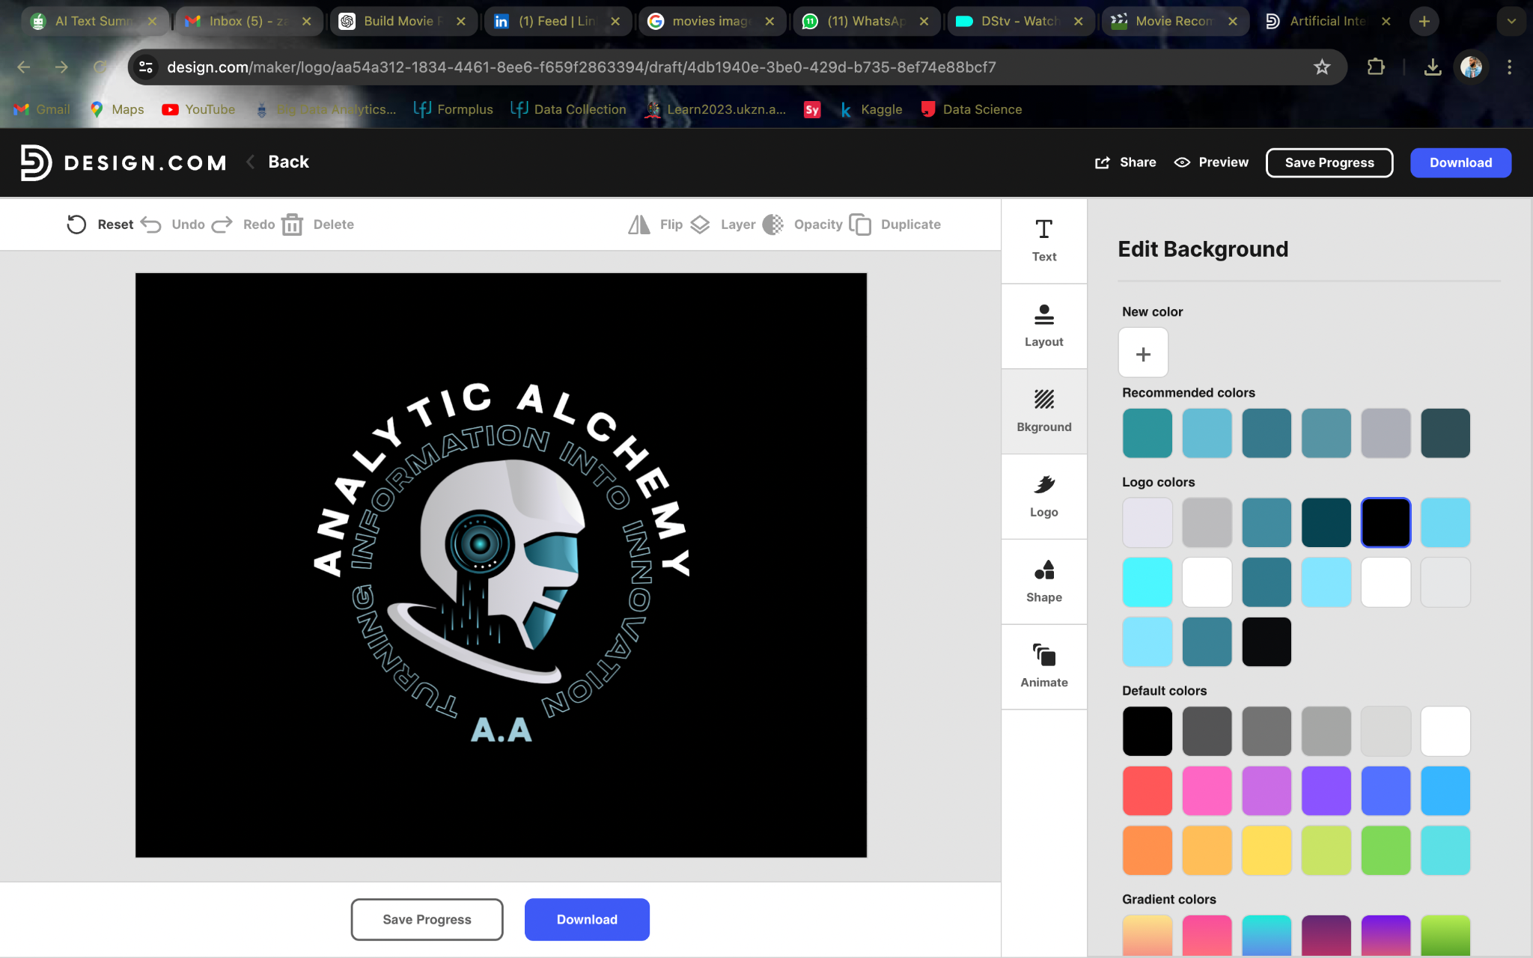
Movie Recommendation Analysis

Slide 2
Introduction
We receive MovieLens datasets scraped from IMDb, a prominent movie website that offers users the ability to watch movies of their choice. These datasets contain comprehensive records including poster, title, ratings, and content. Upon receiving the data, we meticulously clean, merge, and visualize it using Python and Power BI for comprehensive analysis and insights.
Objective
Build a movie recommendation system using (tags,relevance and genre) and content(director, genre, title cast, plot keywords) based information.

Slide 3
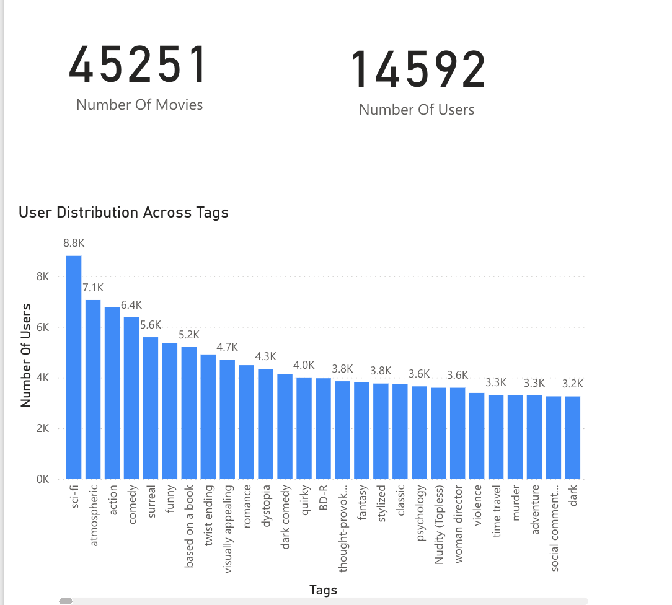

Slide 4
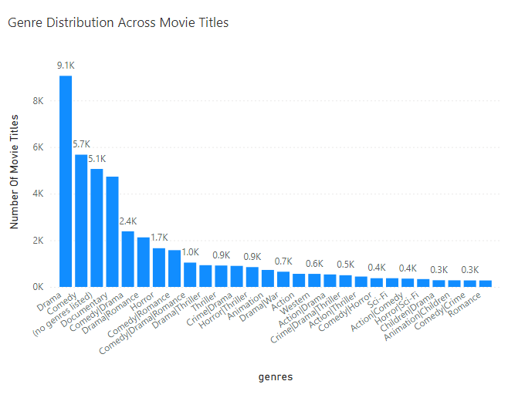

Slide 5
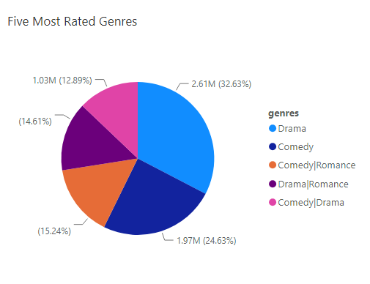

Slide 6
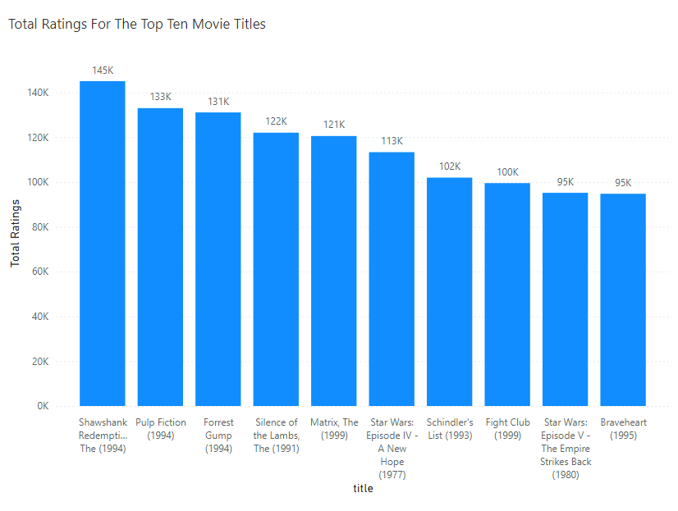

Slide 7
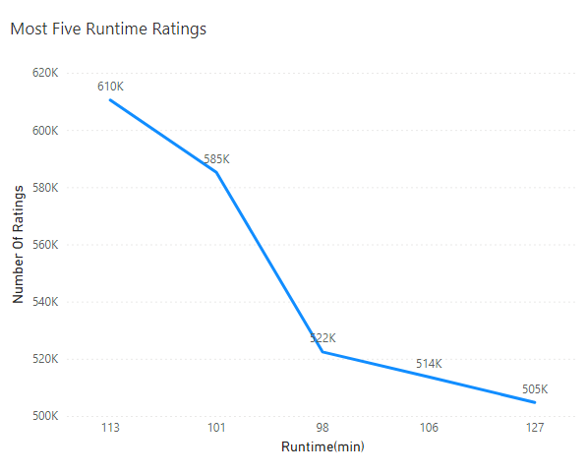

Slide 8
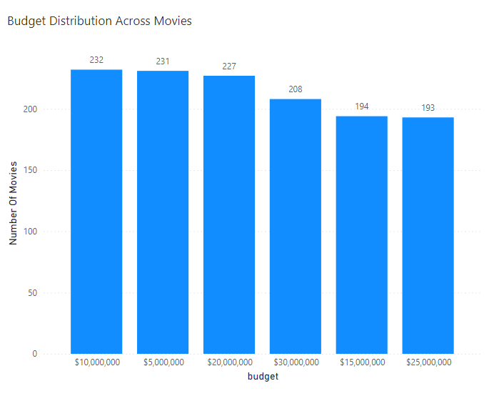

Slide 9
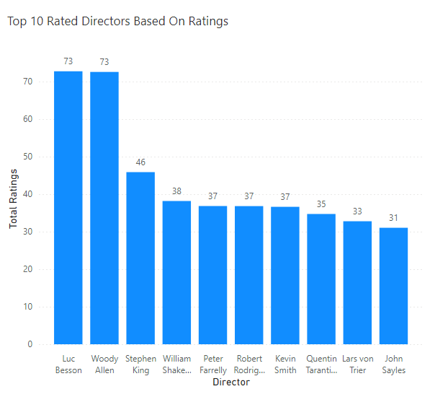

Slide 10
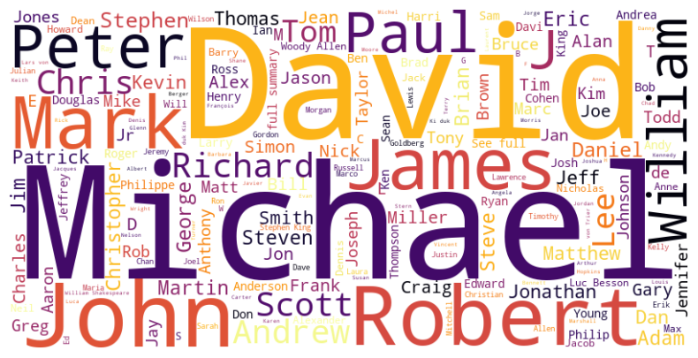
Most Frequently Occurring Directors

Slide 11
Conclusion
The graphical analysis of the MovieLens dataset provides several key insights:
Users generally rate movies favorably, with ratings 3, 4, and 5 being the most common.
Drama, Comedy, and Action are the most popular genres, suggesting these should be prioritized in recommendations.
A small number of users provide a large portion of the ratings, which could affect the generalizability of the recommendation system.
These findings can inform the development of a more nuanced and effective movie recommendation system that takes into account user biases, genre popularity, and evolving trends. By leveraging these insights, the recommendation system can be optimized to enhance user satisfaction and engagement.

Slide 12



